Slide 1
User Interface Analysis
And
Design
1

Slide 2
Introduction
Interface design focuses on the following
  The design of interfaces between software components
  The design of interfaces between the software and other nonhuman producers and consumers of information
  The design of the interface between a human and the computer
Graphical user interfaces (GUIs) have helped to eliminate many of the most horrific interface problems
However, some are still difficult to learn, hard to use, confusing, counterintuitive, unforgiving, and frustrating
User interface analysis and design has to do with the study of people and how they relate to technology

Slide 3

Interface Design
Easy to learn?
Easy to use?
Easy to understand?
Typical Design Errors
lack of consistency
too much memorization
no guidance / help
no context sensitivity
poor response
unfriendly

Slide 4
Golden Rules of User Interface Design
Place the user in control
Reduce the user’s memory load
Make the interface consistent for the user

Slide 5
Place the User in Control
Define interaction modes in a way that does not force a user into unnecessary or undesired actions.
Provide for flexible interaction.
Allow user interaction to be interruptible and undoable.
Streamline interaction as skill levels advance and allow the interaction to be customized.
Hide technical internals from the casual users.
Design for direct interaction with objects that appear on the screen.

Slide 6
Reduce the User’s Memory Load
Reduce demand on short-term memory.
Establish meaningful defaults.
Define shortcuts that are intuitive.
The visual layout of the interface should be based on a real world metaphor.
Disclose information in a progressive fashion.
The more a user has to remember, the more error-prone interaction with the system will be

Slide 7
Make the Interface Consistent
The interface should present and acquire information in a consistent fashion.
Allow the user to put the current task into a meaningful context.
Maintain consistency across a family of applications.
If past interactive models have created user expectations, do not make changes unless there is a compelling reason to do so.

Slide 8
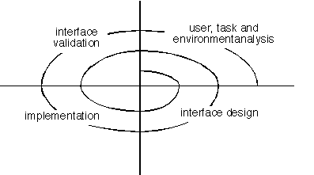
User Interface Design Process
(A Spiral Process)
What is this process called?
How many cycles should there be for your own UI design?

Slide 9
Interface Analysis
Interface analysis means understanding
  (1) the users who will interact with the system through the interface;
  (2) the tasks that end-users must perform to do their work,
  (3) the content that is presented as part of the interface
  (4) the environment in which these tasks will be conducted.

Slide 10
User Analysis
The analyst strives to get the end user's mental model by understanding
  The users themselves
  How these people use the system
Information can be obtained from
  User interviews with the end users
  Sales input from the sales people who interact with customers and users on a regular basis
  Marketing input based on a market analysis to understand how different population segments might use the software
  Support input from the support staff who are aware of what works and what doesn't, what users like and dislike, what features generate questions, and what features are easy to use

Slide 11
User Analysis (Cont…)
A set of questions should be answered during user analysis
  Are users trained professionals, technician, clerical, or manufacturing workers?
  Are the users capable of learning from written materials or have they expressed a desire for classroom training?
  Are users expert typists or keyboard phobic?
  What is the age range, gender, primary spoken language of the user community?
  Is the software to be an integral part of the work users do or will it be used only occasionally?
  Are users experts in the subject matter that is addressed by the system?

Slide 12
Task Analysis and Modeling
Task analysis strives to know and understand
  The work the user performs in specific circumstances
  The tasks and subtasks that will be performed as the user does the work
  The specific problem domain objects that the user manipulates as work is performed
  The sequence of work tasks (i.e., the workflow)
  The hierarchy of tasks
Use-cases define basic interaction
Task elaboration refines interactive tasks
Object elaboration identifies interface objects (classes)
Workflow analysis defines how a work process is completed when several people (and roles) are involved

Slide 13
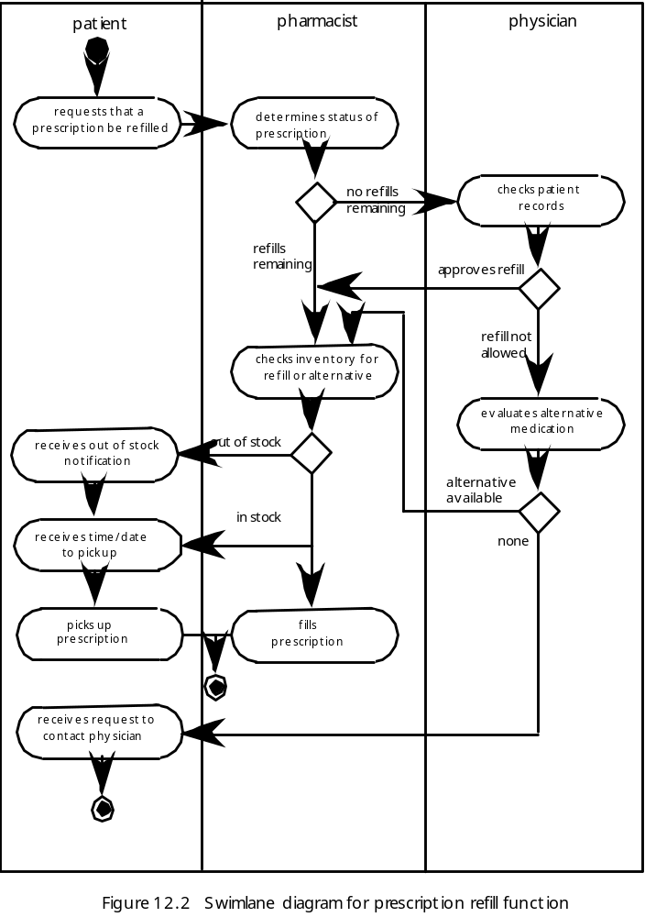
Swimlane Diagram
What kind of diagram is this? What does this have to do with UI design?

Slide 14
Analysis of Display Content
The display content may range from character-based reports, to graphical displays, to multimedia information.
Display content may be
  Generated by components in other parts of the application
  Acquired from data stored in a database that is accessible from the application
  Transmitted from systems external to the application in question
The format and aesthetics of the content needs to be considered

Slide 15
Analysis of Display Content
(Cont…)
A set of questions should be answered during content analysis
  Are different types of data assigned to consistent geographic locations on the screen (e.g., photos always appear in the upper right hand corner)?
  Can the user customize the screen location for content?
  Will graphical output be scaled to fit within the bounds of the display device that is used?
  How will color to be used to enhance understanding?
  How will error messages and warning be presented to the user?

Slide 16
Work Environment Analysis
Software products need to be designed to fit into the work environment, otherwise they may be difficult or frustrating to use
Factors to consider include
  Type of lighting
  Display size and height
  Keyboard size, height and ease of use
  Mouse type and ease of use
  Surrounding noise
  Space limitations for computer and/or user
  Weather or other atmospheric conditions
  Temperature or pressure restrictions
  Time restrictions (when, how fast, and for how long)

Slide 17
User Interface Design
User interface design is an iterative process, where each iteration elaborate and refines the information developed in the preceding step
General steps for user interface design
  Using information developed during user interface analysis, define user interface objects and actions (operations)
  Define events (user actions) that will cause the state of the user interface to change; model this behavior
  Depict each interface state as it will actually look to the end user
  Indicate how the user interprets the state of the system from information provided through the interface •

Slide 18
User Interface Design (Cont…)
During Interface design, the designer must
  Always follow the three golden rules of user interfaces
  Model how the interface will be implemented
  Consider the computing environment (e.g., display technology, operating system, development tools) that will be used

Slide 19
Interface Objects and Actions
Interface objects and actions are obtained from a grammatical parse of the use cases and the software problem statement
Interface objects are categorized into types: source, target, and application
  A source object is dragged and dropped into a target object such as to create a hardcopy of a report
  An application object represents application-specific data that are not directly manipulated as part of screen interaction such as a list

Slide 20
Design Issues to Consider
Four common design issues usually surface in any user interface
  System response time (both length and variability)
  User help facilities
    When is it available, how is it accessed, how is it represented to the user, how is it structured, what happens when help is exited
  Error information handling
    How meaningful to the user, how descriptive of the problem
  Menu and command labeling
    Consistent, easy to learn, accessibility, internationalization
Many software engineers do not address these issues until late in the design or construction process
  This results in unnecessary iteration, project delays, and customer frustration

Slide 21
Interface Construction
Begins with a prototype that enables usage scenarios to be evaluated
Continues with development tools to complete the construction

Slide 22
Interface Validation
Interface Validation focus on
  The ability of the interface to implement every user task correctly, to accommodate all task variations, and to achieve all general user requirements
  The degree to which the interface is easy to learn, easy to use, easy to understand.
  The users' acceptance of the interface as a useful tool in their work

